Slide 1
Copyright year in review: 2021

Slide 2
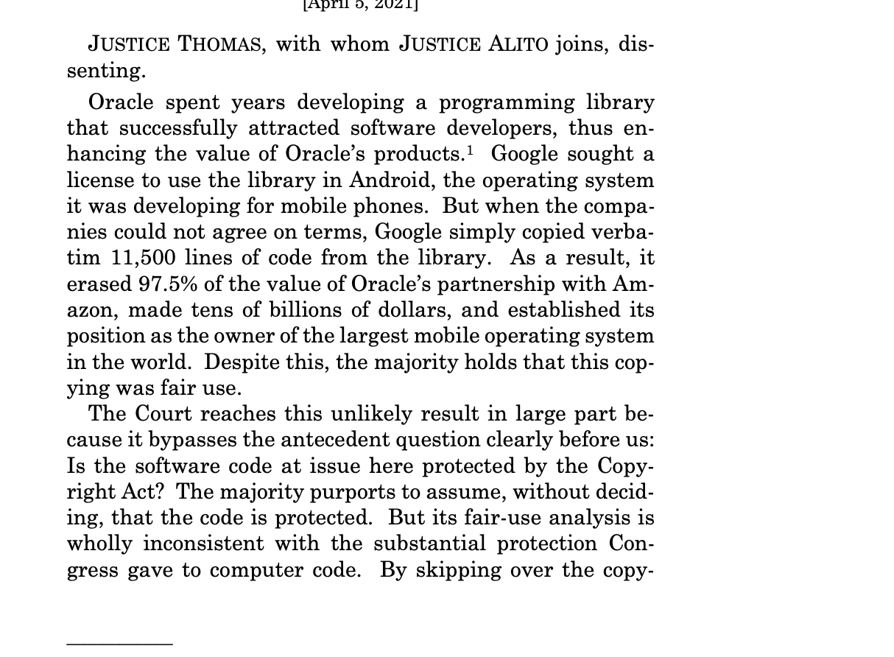
The big one: oracle v. google

Slide 3
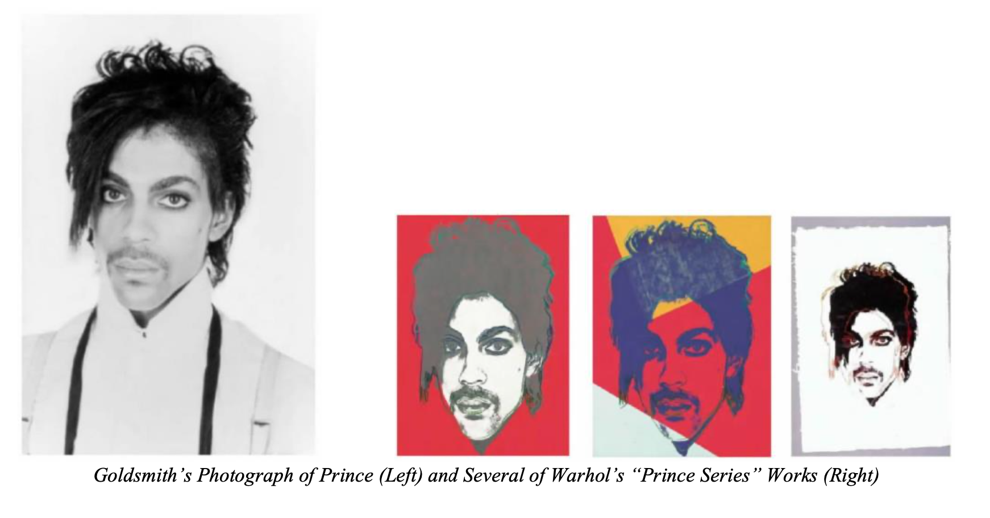
In other fair use developments… Warhol v. goldsmith (2d Cir.)

Slide 4
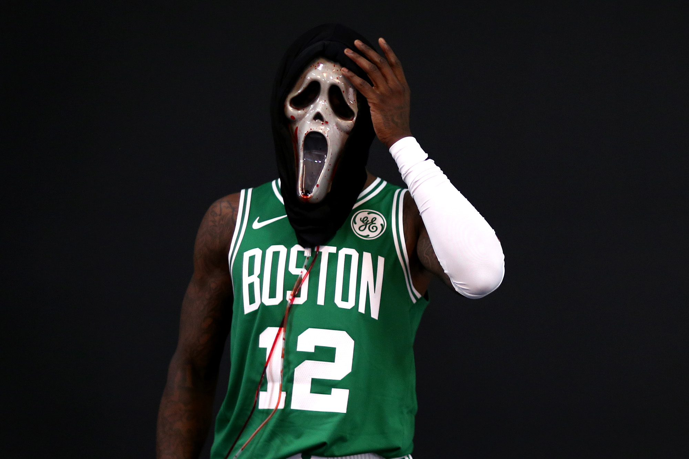
In even more fair use news…
Easter Unlimited, Inc. v. Rozier (E.D.N.Y.)
Apple Inc. v. Corellium (S.D. Fla.)
Brown v. Netflix (2d Cir.)
Grant et al. v. Trump (S.D.N.Y)
Who put the bomp in the
bomp, bomp, bomp?

Slide 5
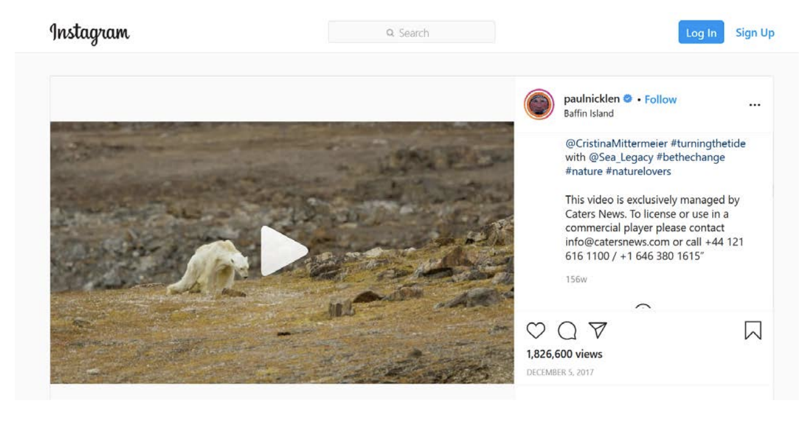
The server test, tested
Bell v. Wilmott Storage Services (9th Cir.)
Hunley et al. v. Instagram (N.D. Cal)
Nicklen v. Sinclair Broadcasting Group Inc. (S.D.N.Y)

Slide 6
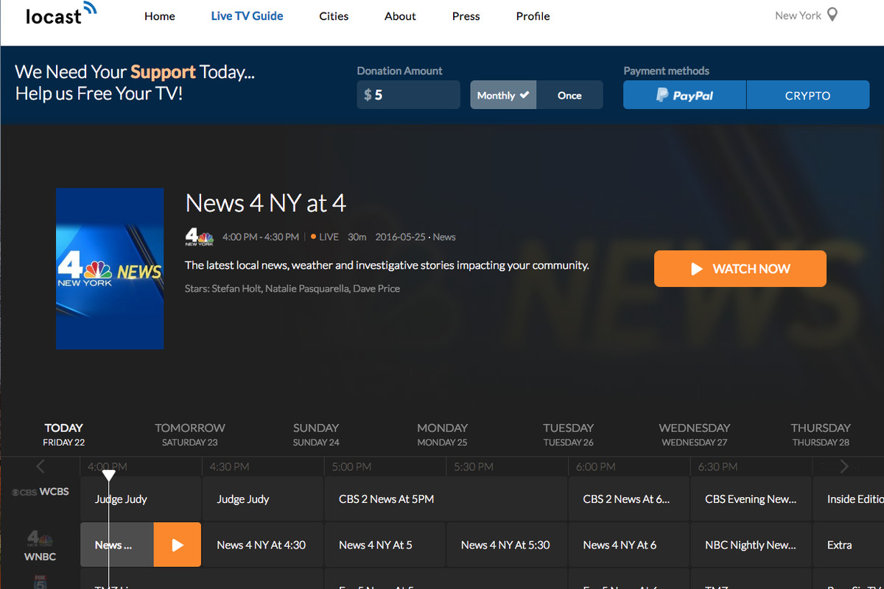
Section 111a
American Broadcasting Cos. Inc. et al. v. Goodfriend et al. (S.D.N.Y)

Slide 7
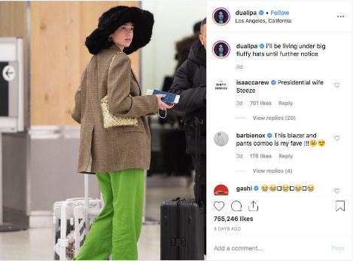
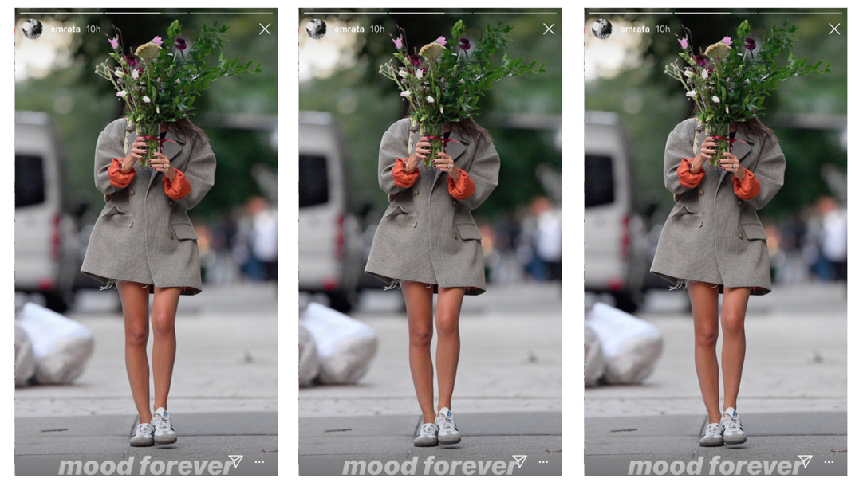
In other photographer suits…
O’Neil v. Ratajkowski (S.D.N.Y.)
Integral Images Inc. v. Lipa (C.D. Cal.)

Slide 8
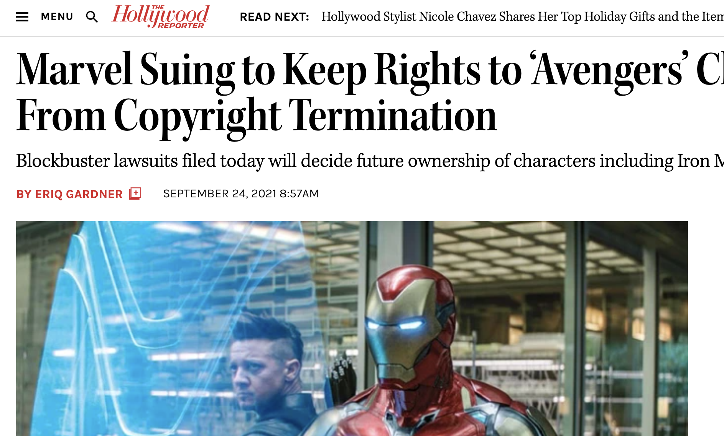
Termination rights
Horror Inc. et al. v. Miller (2d Cir.)
Lil' Joe Records Inc. et al. v. Ross et al. (S.D. Fla.)
Clancy v. Webb (D. Md.)
And the biggest….

Slide 9
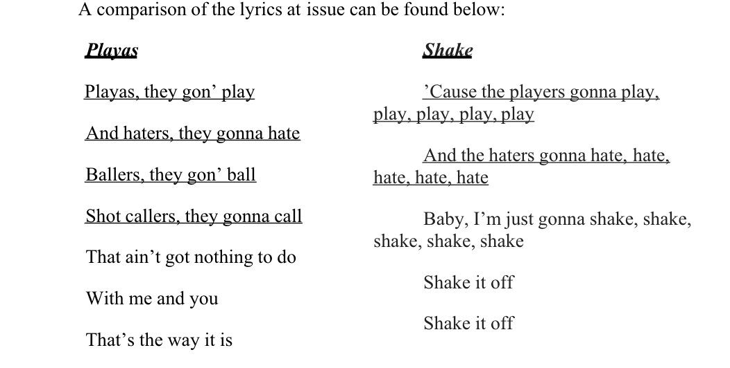
substantial similarity
Hall v. Swift (C.D. Cal.)
Clover et al. v. Abel Tesfaye (9th Cir.)
Johannsongs-Publishing Ltd. v. Lovland et al. (9th Cir.)
Alfred et al v. Disney (C.D. Cal.)
Hajim v. Endemol Shine UK (N.D. Ill.)

Slide 10
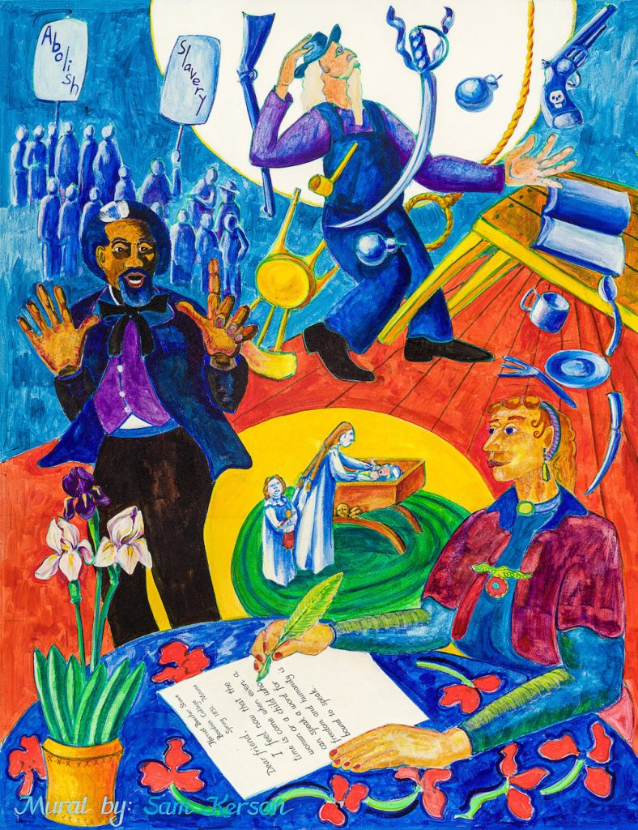
A RARE VARA CASE
Kerson v. Vermont Law School
(D. Vermont)

Slide 11
Governmental immunity & TAKINGS
Canada Hockey et al. v. Texas A&M et al. (5th Cir.)
Jim Olive Photography v. University of Houston System (Tex. Sup. Ct.)

Slide 12
Pre-72s
The interminable….Flo & Eddie v. Sirius XM (9th Cir.)

Slide 13
…and other state law claims
Karen Hepp. V. Facebook (3d Cir.)
47 U.S. Code § 230
(e ) Effect on other laws
….
(2) No effect on intellectual property law
Nothing in this section shall be construed to limit or expand any law pertaining to intellectual property.

Slide 14
nfts
Tarantino v. Miramax (C.D. Cal.)
Roc-A-Fella v. Dash (S.D.N.Y)

Slide 15
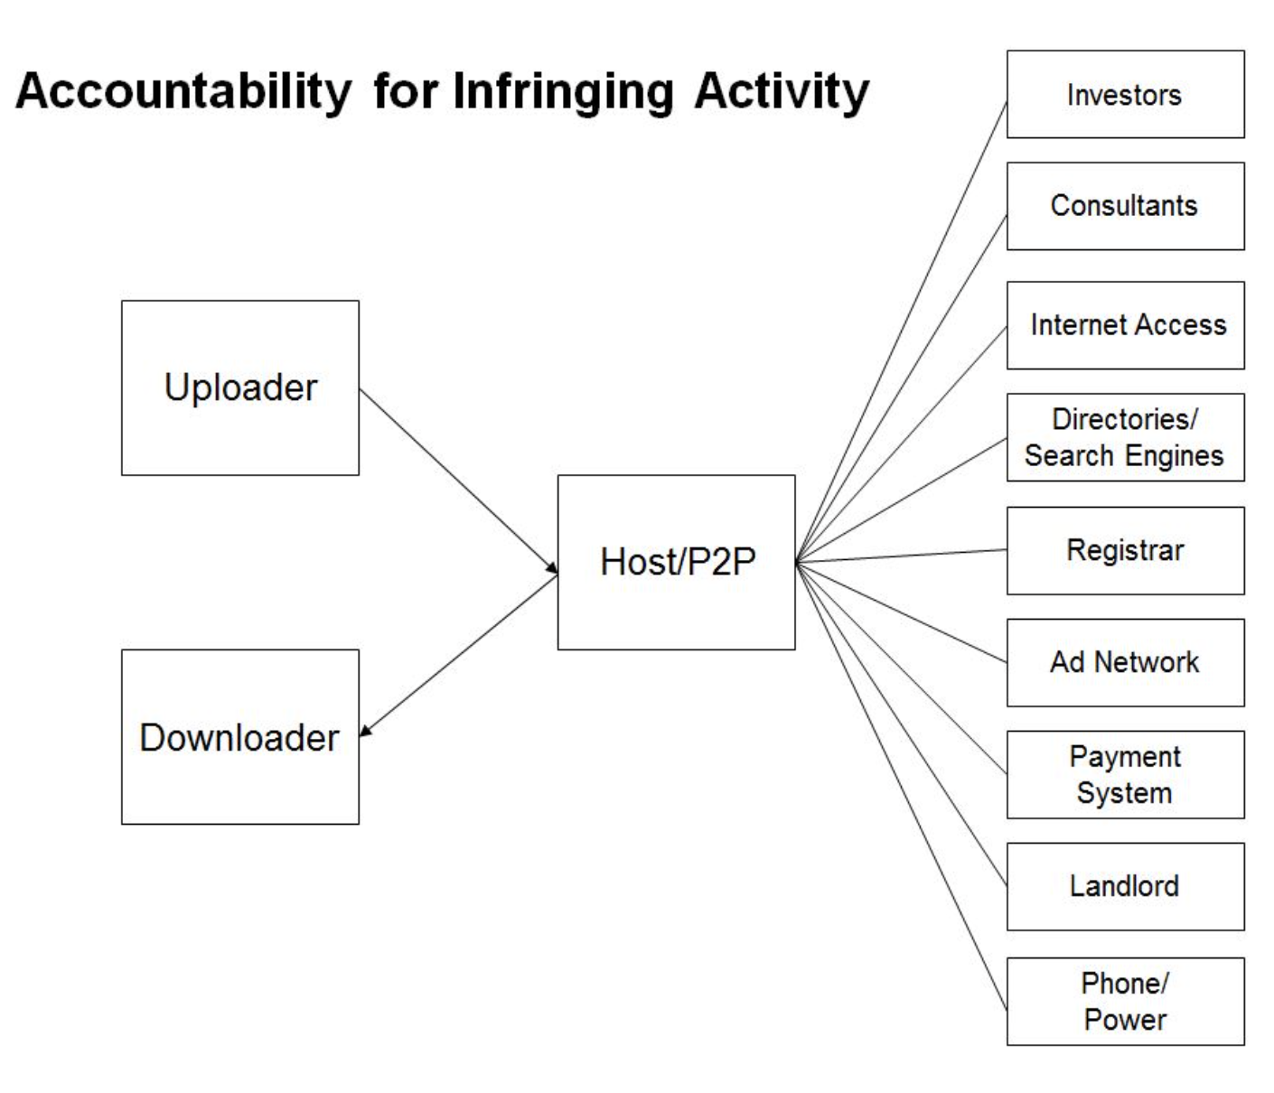
Contributory infringement
Mon Cheri Bridals v. Cloudflare (N.D. Cal.)

Slide 16
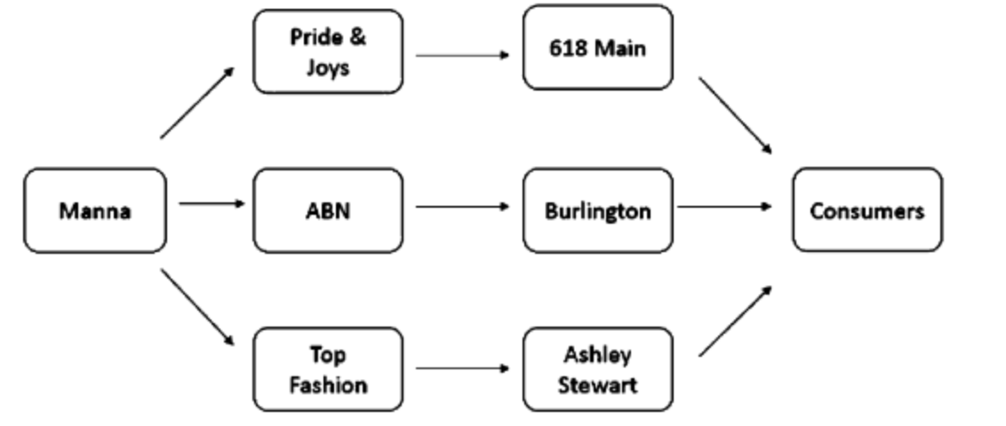
DAMAGES
Desire LLC v. Manna Textiles (9th Cir.)
Rearden LLC et al. v. Disney (N.D. Cal.) (and similar suits against Paramount and Twentieth Century Fox)

Slide 17
Copyright trolls
Attorney Richard Liebowitz suspended (twice)
Strike 3 Holdings v. John Doe (9th Cir.)
Design Basics v. Kerstiens Homes & Designs (7th Cir.)

Slide 18
Copyright office developments
Modernization efforts
Section 1201 Eighth Triennial Rulemaking
Copyright Claims Board
Web V (streaming royalties)
Phonorecords IV
Phonorecords III remand
Deferred copyright examination

Slide 19
Other DIGITAL STREAMING developments
Mechanical Licensing Collective
DOJ Consent Decrees survive (for now)
IA disbands

Slide 20
industry developments to watch
The techlash
Rerecords
And speaking of Taylor… (TAS Rights Management LLC v. Evermore Park LLC et al. (M.D. Tenn.))
Illegal dubbing? (Hollywood Innovations Group v. Netflix)

Slide 21
2022 cases to watch
H&M v. Unicolors (SCOTUS)
Kihn v. Bill Graham Archives (9th Cir.)
SAS v. WPL (Fed. Cir.)

Slide 22
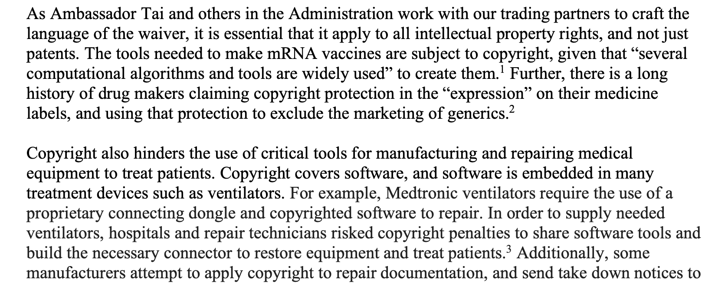
Covid IP waiver

Slide 23
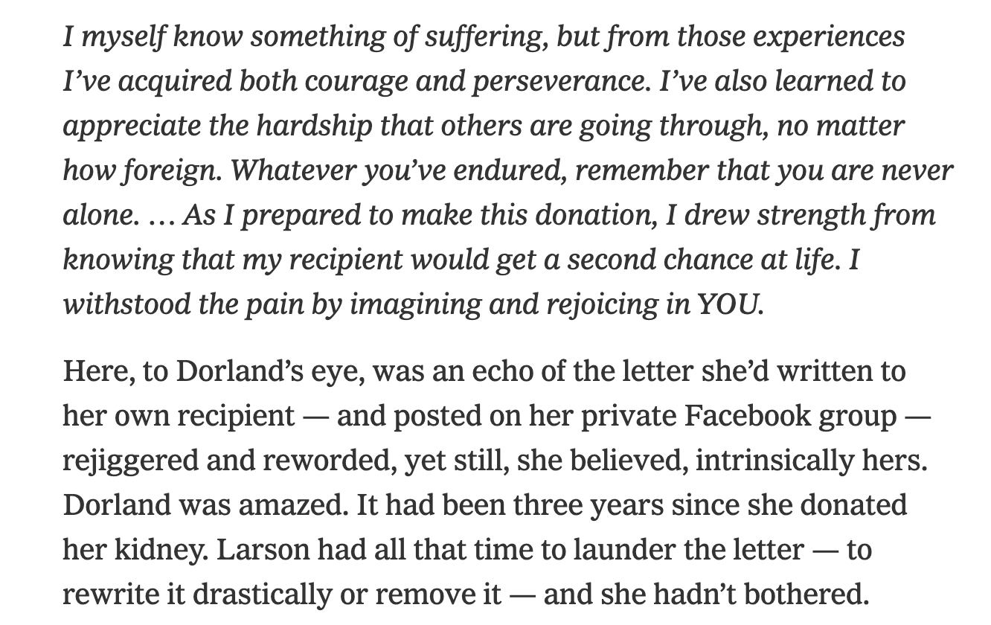
And finally….
Are you a bad copyright friend?

